Slide 1


Review-I
Design and Development of a
Solar E-Bicycle with an Embedded based Smart Monitoring System
AY 2025-26
Capstone Project – Introduction (PROJ2999)
GITAM (Deemed-to-be) University
Department of Electrical Electronics and Communication Engineering
Project Team:
Karthik S
Manasanthosh Y
Salomi S
Rakshitha N
Project Mentor:
Dr. Seetha Chaithanya
Project In-charge:
Dr. Kshitij Shakya
www.gitam.edu

Slide 2
Objective and Goals
Objective
To design and develop a solar-powered electric bicycle with an IoT dashboard that utilizes renewable energy, provides real-time monitoring, and promotes safe, smart, and sustainable urban mobility.
Goals
Main Goals
Solar + plug-in charging (continuous battery)
BLDC hub motor drive (efficient & sustainable)
IoT dashboard (battery, speed, distance, solar status)
Smartphone connectivity (performance data & alerts)

Slide 3
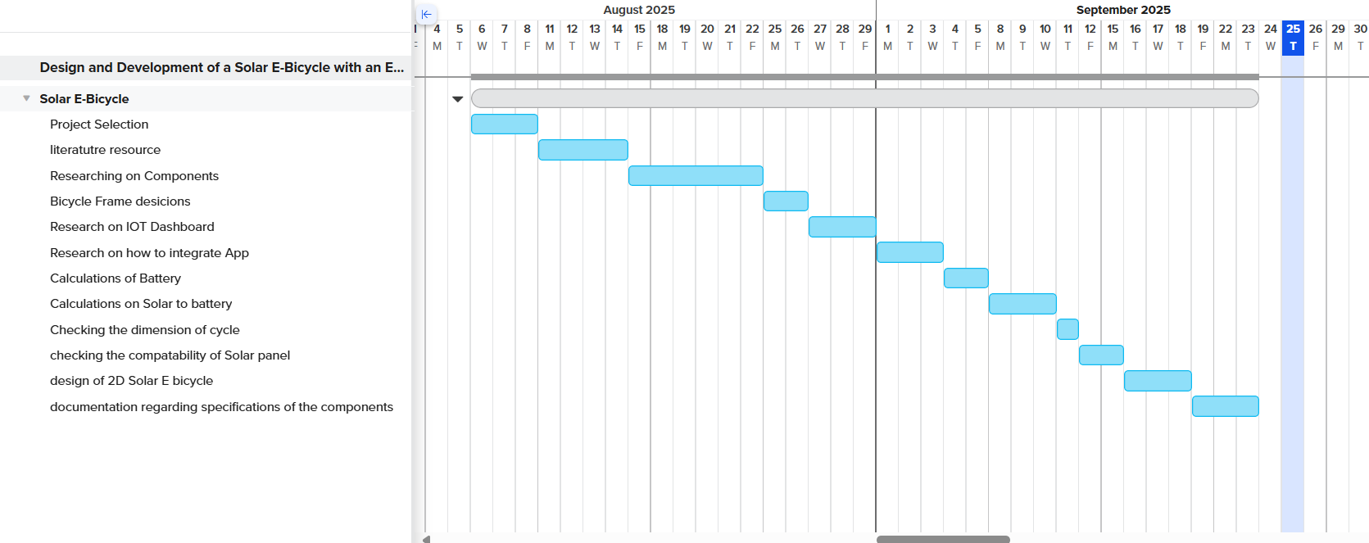
Project Plan (Clearly mention milestone for objectives under each reviews)

Slide 4
Literature Survey
Publications:
Solar-powered bicycle techniques – T. Suresh (2021)
Solar vehicle design – Hema Latha, (2019)
Solar bicycle implementation – P. Maheswara Rao, (2024)
E-bike sharing systems – S. Adhisuwignjo, (2017)
Key Resources:
BLDC motor & controller guides
Battery & BMS datasheets
MPPT charge controller datasheets
Standards: IEC 62133, IEEE 1562, IS
Existing Implementations:
Open-source e-bike hardware/software
DIY modular controllers & displays
E-bike analytics & instrumentation repositories

Slide 5
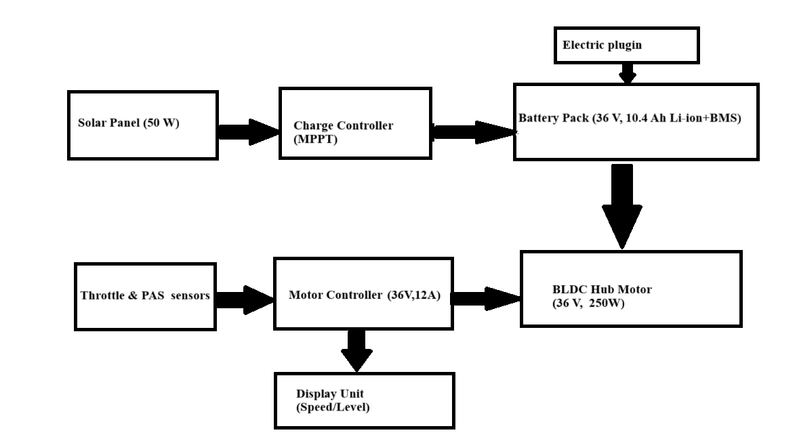
Proposed Architecture of the Solar E - bicycle

Slide 6
Use Cases
Use Cases
Useful for connecting commuters from public transport hubs (bus, metro, train stations) to their final destination.
Solar e-bikes can be rented for sightseeing, campus rides, or eco-tourism projects.
Lower operational and maintenance costs compared to petrol-based vehicles.
Solar charging further reduces electricity expenses.

Slide 7
Main Components required for the project
Brushless DC HUB motor (BLDC) (36V,250 W)
Trapezoidal Controller (36V)
Solar panel (50W)
Maximum power point tracking controller (MPPT) (12/24V)
ESP-32
OLED 128*64

Slide 8
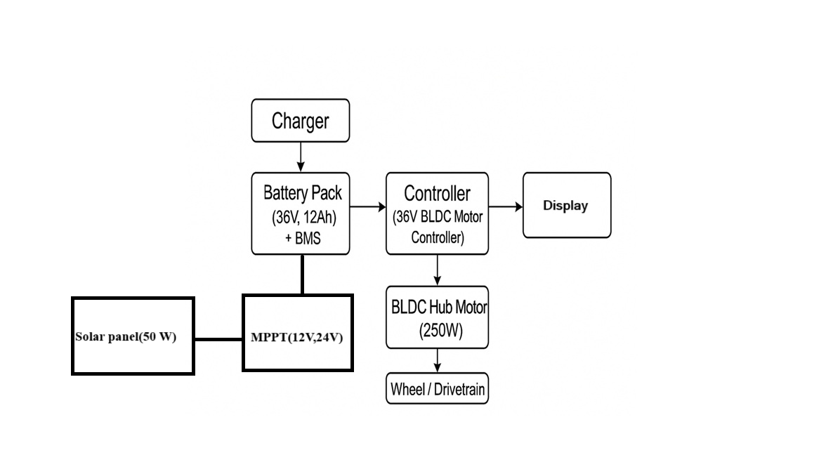
Integration of Hardware components

Slide 9
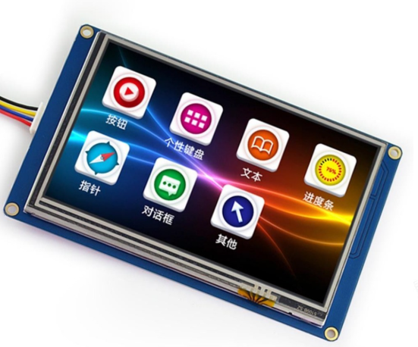
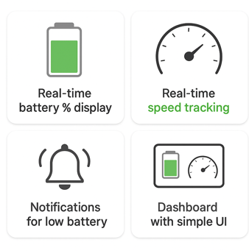
The Integration of IOT Dashboard for real time monitoring
Monitoring Features
Real-time Monitoring
  Battery %, speed, distance, solar input
Performance Insights
  Trip history, energy usage
App & Connectivity
Smartphone App
  Live data & alerts
Connectivity
  Bluetooth / Wi-Fi integration

Slide 10
Software Integration in IoT Devices
OLED Design for E-Bicycle
IOT components:
ESP-32
OLED 128*64
Connection ports
DS3231 RTC MODULE
CR2032
SDCARD

Slide 11
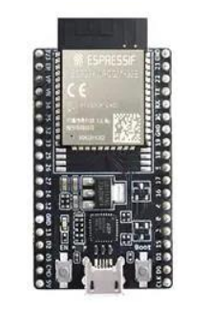
ESP-32
It has built-in Wi-Fi & Bluetooth, so no extra communication modules are needed.
It gives high processing speed, enough for sensors + OLED + IoT tasks together.
It supports all required interfaces (I2C, SPI, ADC), so all sensors and OLED can connect easily.
It is low-power, making it perfect for a solar-powered bicycle.
It is cheap and easy to program, reducing project cost and complexity.

Slide 12
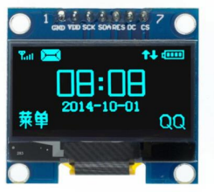
OLED 128*64
OLED means Organic LED – it produces its own light, so no backlight is needed.
The resolution is 128×64, which gives clear text and graphics.
It has high contrast and bright display, easy to see even in sunlight (good for solar bicycle).
Low power consumption, makes it suitable for battery-powered and IoT projects.
Uses I2C or SPI interface, so it connects easily with ESP-32.
Displays text, icons, battery level, speed, voltage, current, etc.

Slide 13
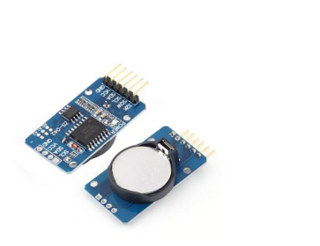
DS3231 RTC MODULE
RTC (Real-Time Clock) – it keeps accurate time (hours, minutes, seconds, date).
DS3231 is a highly accurate RTC with very low time error because it has a built-in temperature-compensated crystal oscillator.
It works even when the main power is OFF because it has a backup battery.
Uses I2C communication, so it easily connects with ESP-32.
Used to display real-time clock, date, alarms, logging time, and scheduling functions in IoT projects.

Slide 14
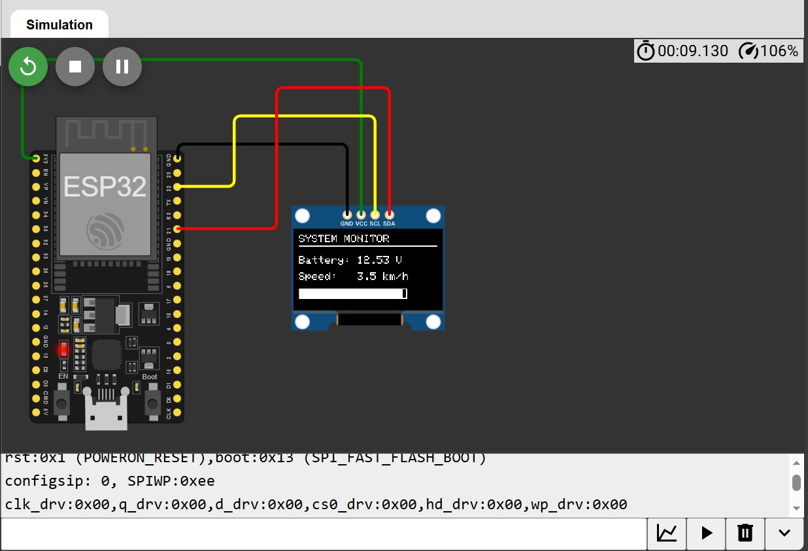
RESULTS

Slide 15
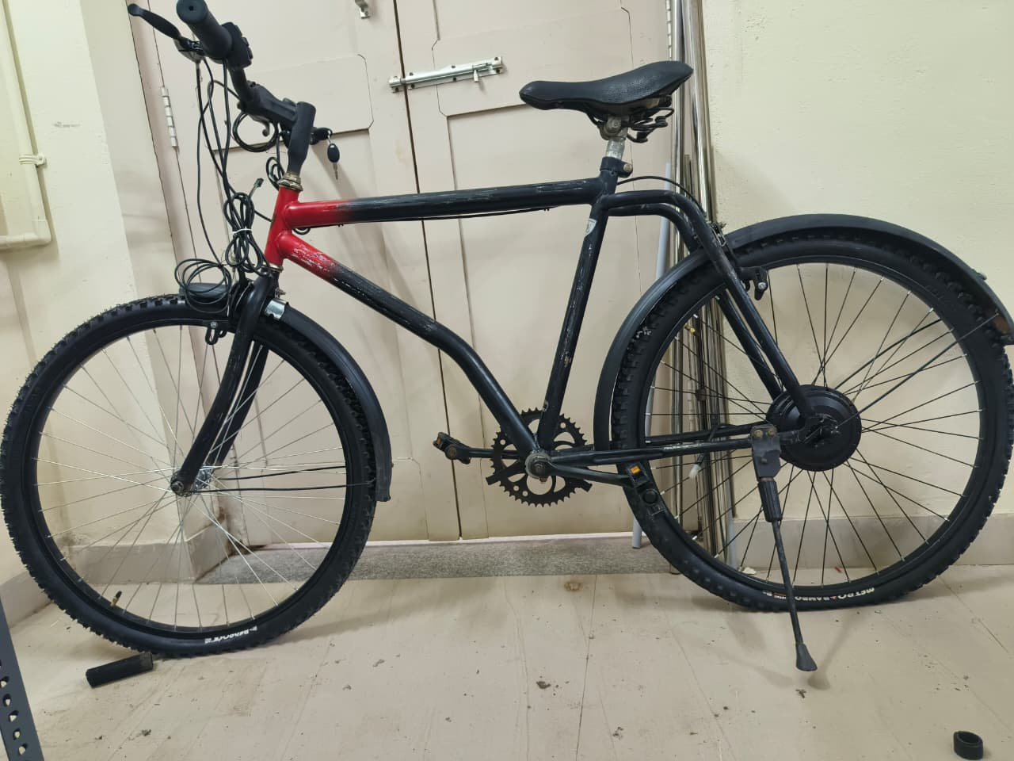
Bicycle

Slide 16
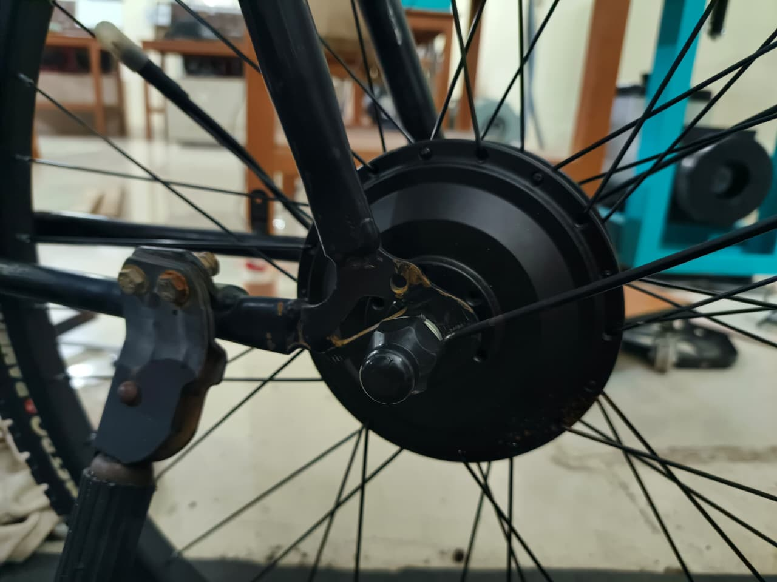
Brushless DC HUB motor (BLDC)

Slide 17
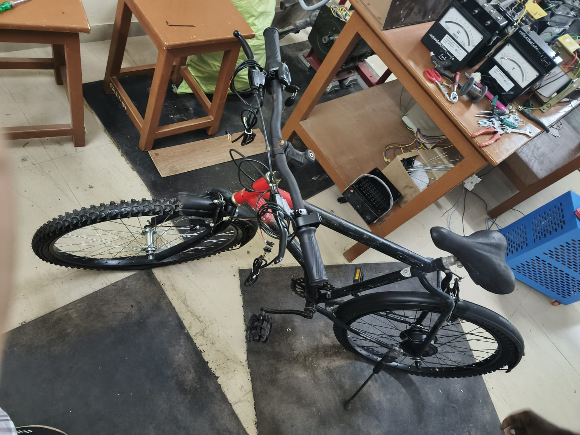
Throttle & Break Levers

Slide 18
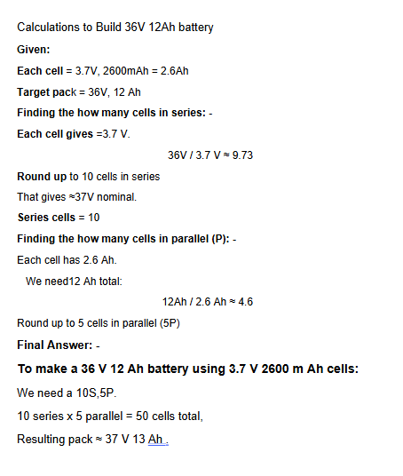
Battery Pack Calculation:

Slide 19
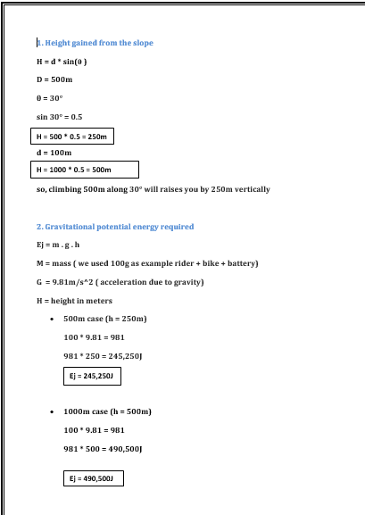
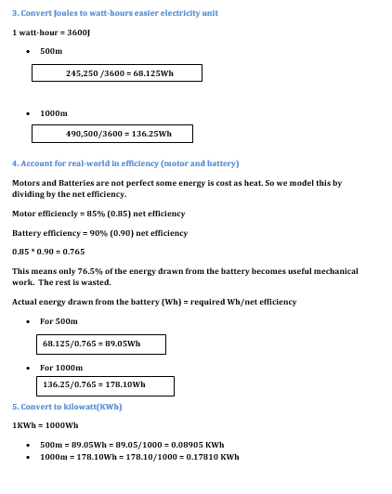
Energy Calculation for Slope Climbing in a Solar E- Bicycle

Slide 20
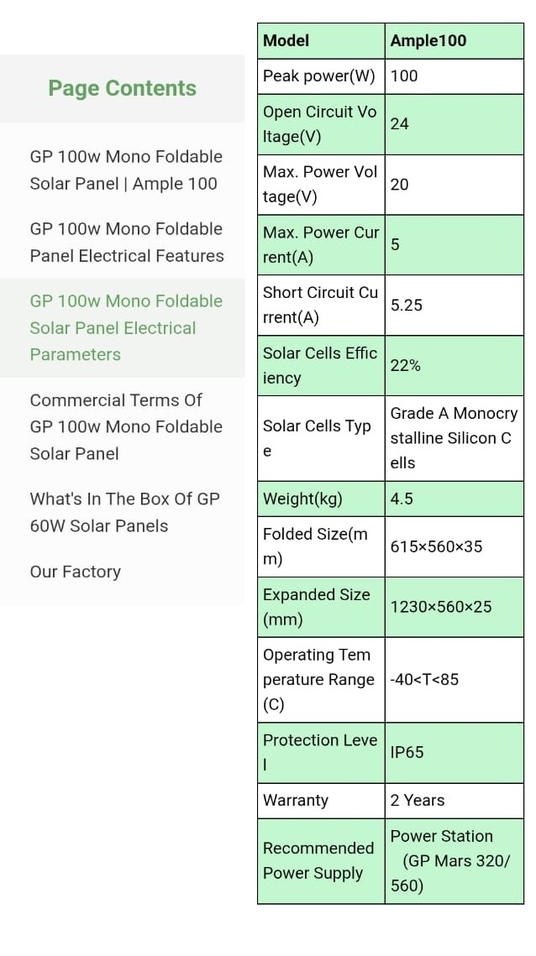
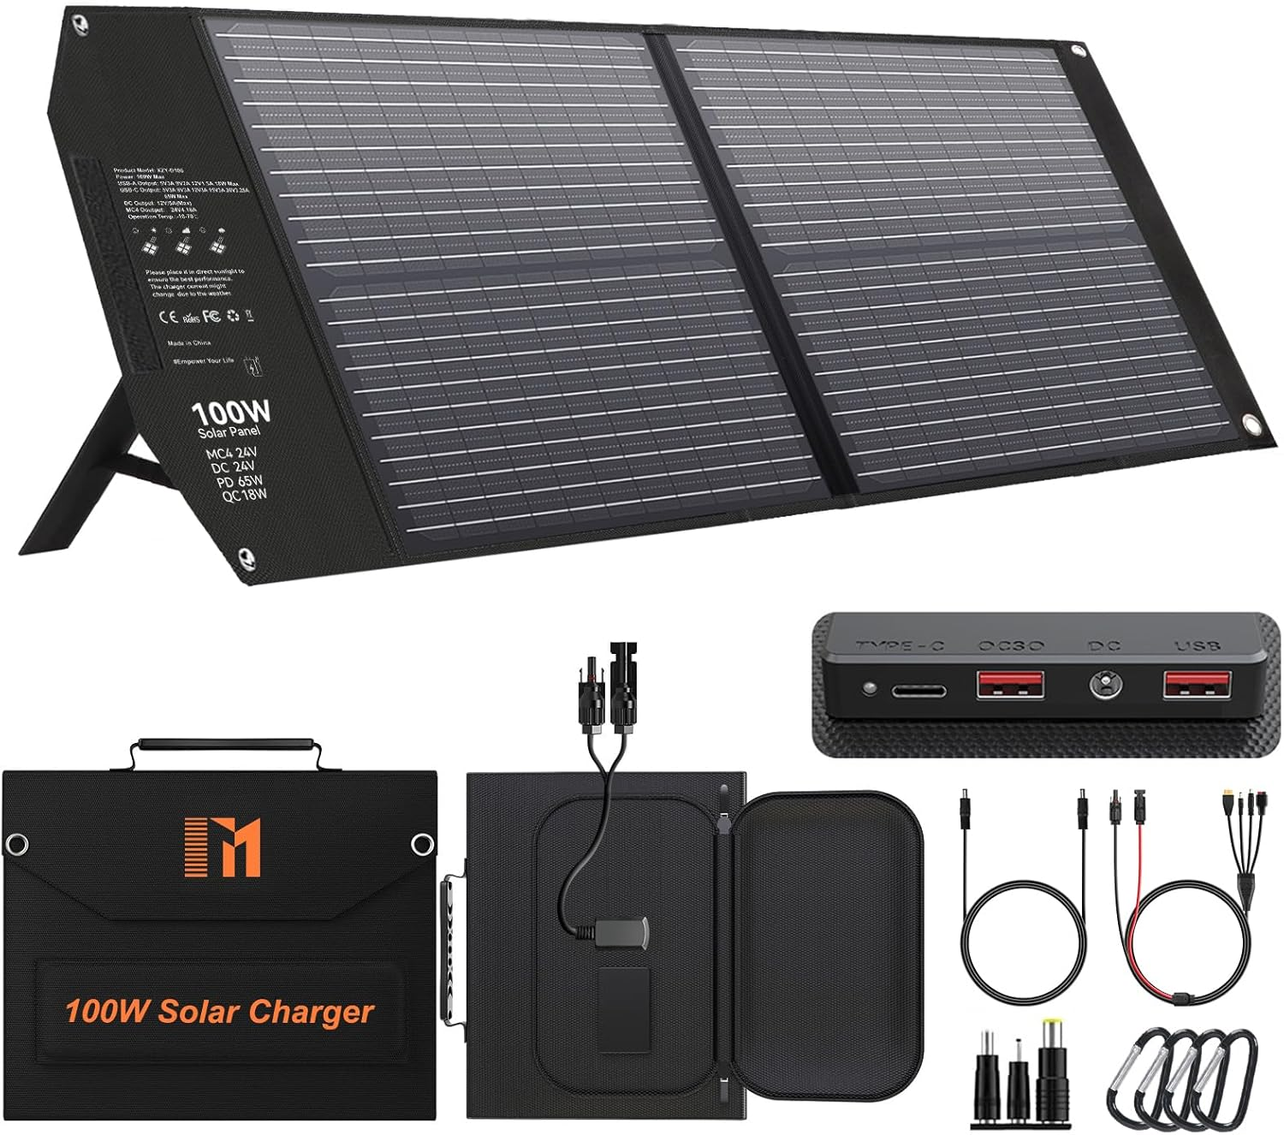
Solar Panel Specifications

Slide 21
CONCLUSION
The project team successfully completed the essential mechanical and electrical integrations required for the Solar E-Bicycle . The BLDC hub motor, throttle, and brake levers were properly fixed . Alongside the hardware setup, the IoT-based monitoring system was developed using online simulation platform (Wokwi - World's most advanced ESP32 Simulator) , where the ESP-32 logic, OLED display interface, and sensor integrations were coded and validated.
Battery capacity calculations and Solar Panel Power calculations were performed to determine proper energy requirements for continuous operation. These results confirm that the selected battery pack and solar charging system are capable of supporting the bicycle’s performance and energy needs.
Overall, the project demonstrates the feasibility of integrating renewable solar energy with smart IoT monitoring in an electric bicycle. The ongoing work on hardware connections, simulations, coding, and power calculations shows steady progress toward developing a Solar E Bicycle.

Slide 22
THANK YOU
Have a Great Day !

